Slide 1
Microsoft Configuration Service Providers
Dec 2018
M5
Microsoft 365 Device Series

Slide 2
Agenda
Configuration Service Providers
CSP Reference
Windows 10
Mobile Devices

Slide 3

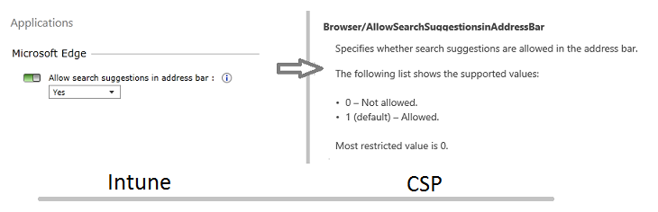
What is Microsoft CSP
An interface in the client operating system between configuration settings specified in a provisioning document and configuration settings on the device.
Notes:
A CSP is an interface in the client operating system between configuration settings specified in a provisioning document and configuration settings on the device. Their function is similar to that of Group Policy client-side extensions in that they provide an interface to read, set, modify, or delete configuration settings for a given feature. Typically, these settings map to registry keys, files or permissions. Some of these settings are configurable and some are read-only.
Starting in Windows Mobile 5.0, CSPs were used to manage Windows mobile devices. In the Windows 10 platform, the management approach for both desktop and mobile devices converges, taking advantage of the same CSPs to configure and manage all devices running Windows 10.
Each CSP provides access to specific settings. For example, the Wi-Fi CSP contains the settings to create a Wi-Fi profile.
CSPs are behind many of the management tasks and policies for Windows 10 in Microsoft Intune and non-Microsoft MDM service providers. For example, in Intune, the policy to allow search suggestions in the Microsoft Edge address bar uses Browser/AllowSearchSuggestionsinAddressBarin the Policy CSP.

Slide 4
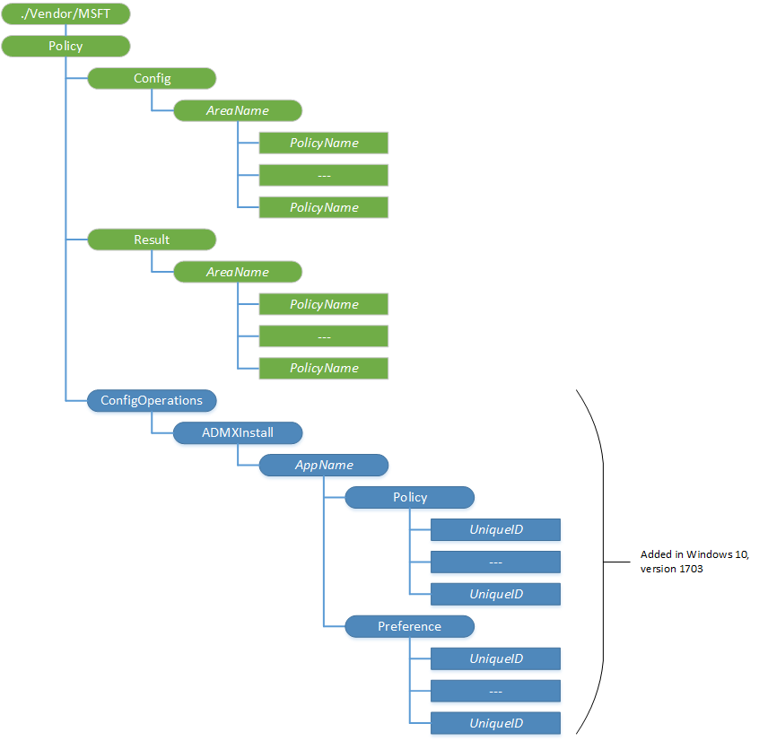
Why should you learn about CSPs?
Traditional MGMNT
CSP
GPOs
MDM policies
MDM using CSP
Custom settings not available at MDM
Notes:
Generally, enterprises rely on Group Policy or MDM to configure and manage devices. For devices running Windows, MDM services use CSPs to configure your devices.
In addition, you may have unmanaged devices, or a large number of devices that you want to configure before enrolling them in management, or you want to apply custom settings that aren't available through your MDM service. The CSP documentation can help you understand the settings that can be configured or queried.
In addition, some of the topics in the Windows 10 and Windows 10 Mobile library on Technet include links to applicable CSP reference topics, such as Cortana integration in your business or enterprise which links to the Policy CSP. In the CSP topics, you can learn about all of the available configuration settings.
Policy/Config
Node for grouping all policies configured by one source. The configuration source can use this path to set policy values and later query any policy value that it previously set. One policy can be configured by multiple configuration sources. If a configuration source wants to query the result of conflict resolution (for example, if Exchange and MDM both attempt to set a value,) the configuration source can use the Policy/Result path to retrieve the resulting value.
Supported operation is Get.
The Policy configuration service provider enables the enterprise to configure policies on Windows 10. Use this configuration service provider to configure any company policies.

Slide 5
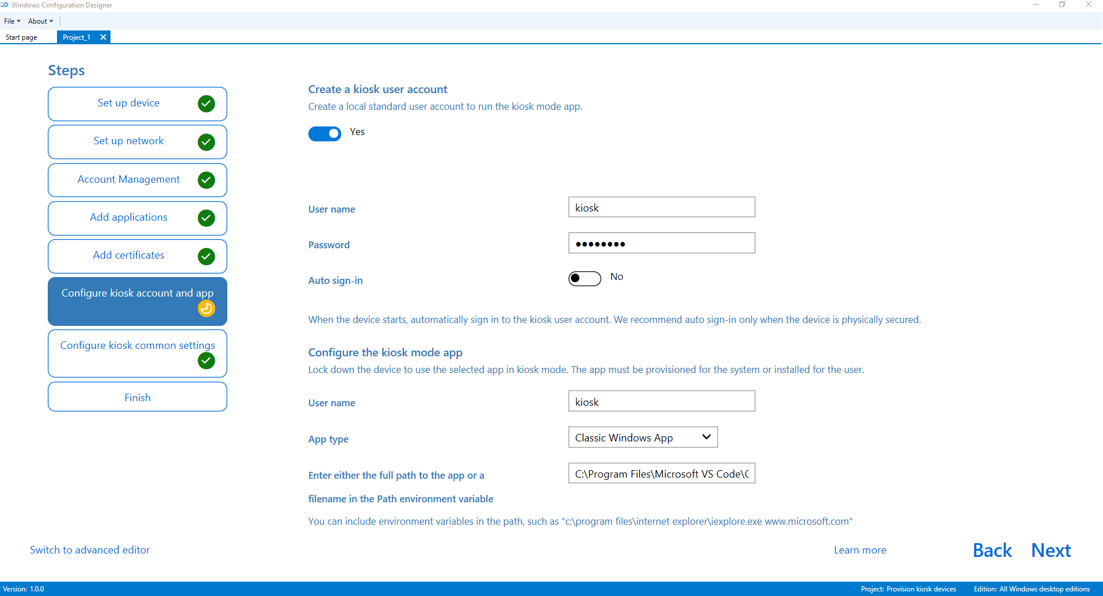
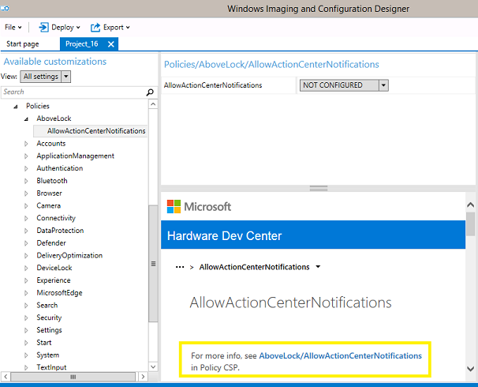
CSPs in Windows Configuration Designer
You can use Windows Configuration Designer to
Create provisioning packages
Apply settings to devices during the out-of-box-experience (OOBE) and after devices are set up.
Configure a device's connectivity and enroll the device in MDM.
Notes:
Check relevance for Microsoft 365

Slide 6
CSP Reference

Slide 7
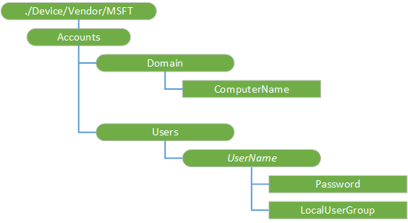

Account CSP
The Accounts CSP is used by the enterprise to rename a device, to create a new local Windows account and join it to a local user group.

Slide 8
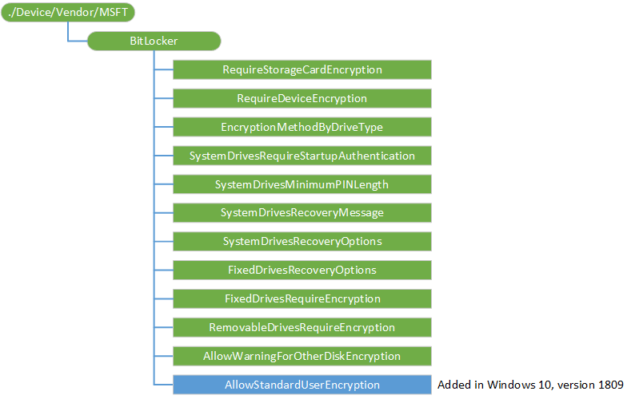

BitLocker CSP
The BitLocker configuration service provider (CSP) is used by the enterprise to manage encryption of PCs and devices.

Slide 9

CellularSettings CSP
The CellularSettings configuration service provider is used to configure cellular settings on a mobile device.

Slide 10
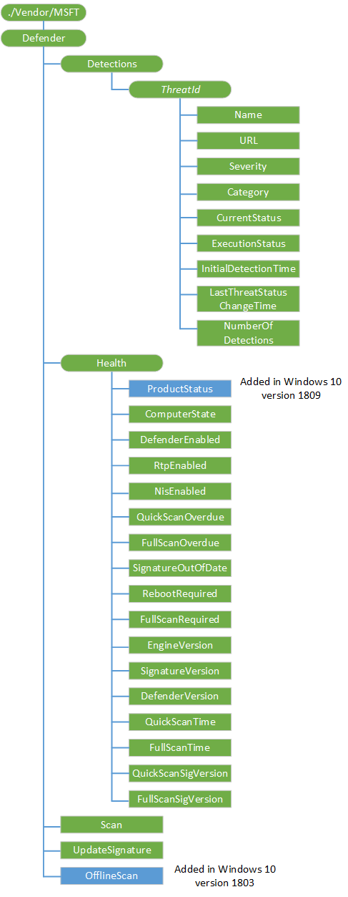
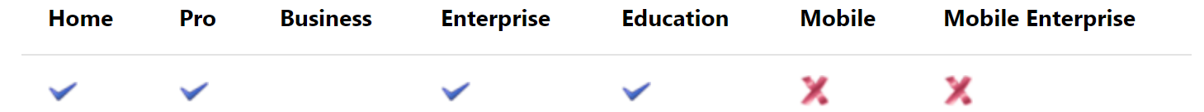
Defender CSP
The Windows Defender configuration service provider is used to configure various Windows Defender actions across the enterprise.

Slide 11
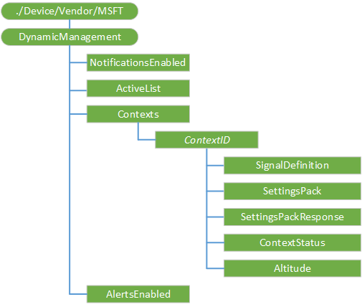

DynamicManagement CSP
Windows 10 allows you to manage devices differently depending on location, network, or time.

Slide 12
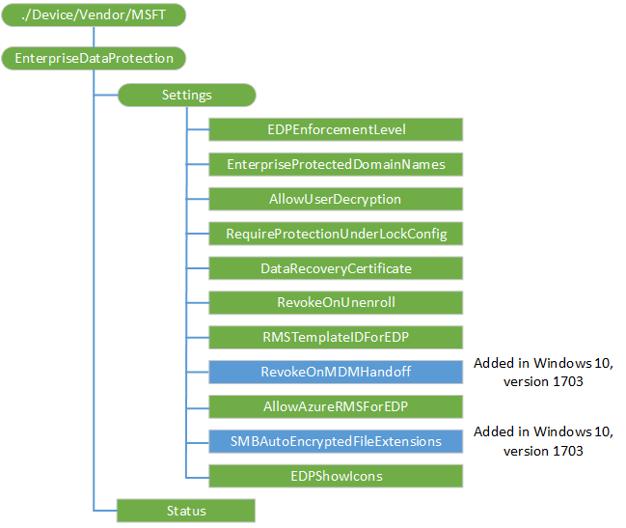

EnterpriseDataProtection CSP
The EnterpriseDataProtection configuration service provider (CSP) is used to configure Windows Information Protection (WIP) (formerly known as Enterprise Data Protection) specific settings.

Slide 13
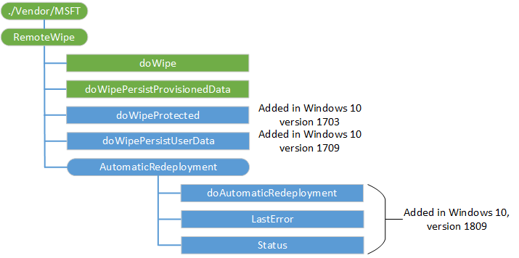

RemoteWipe CSP
The RemoteWipe configuration service provider can be used by mobile operators DM server or enterprise management server to remotely wipe a device.
Notes:
The RemoteWipe configuration service provider can be used by mobile operators DM server or enterprise management server to remotely wipe a device. The RemoteWipe configuration service provider can make the data stored in memory and hard disks difficult to recover if the device is remotely wiped after being lost or stolen.
The following diagram shows the RemoteWipe configuration service provider management object in tree format as used by both OMA DM and OMA Client Provisioning. Enterprise IT Professionals can update these settings by using the Exchange Server.

Slide 14
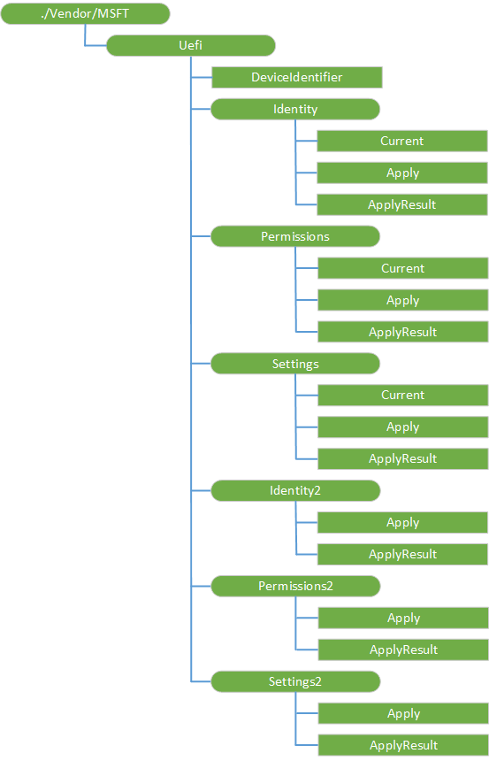

UEFI CSP
The UEFI configuration service provider (CSP) interfaces to UEFI's Device Firmware Configuration Interface (DFCI) to make BIOS configuration changes.

Slide 15
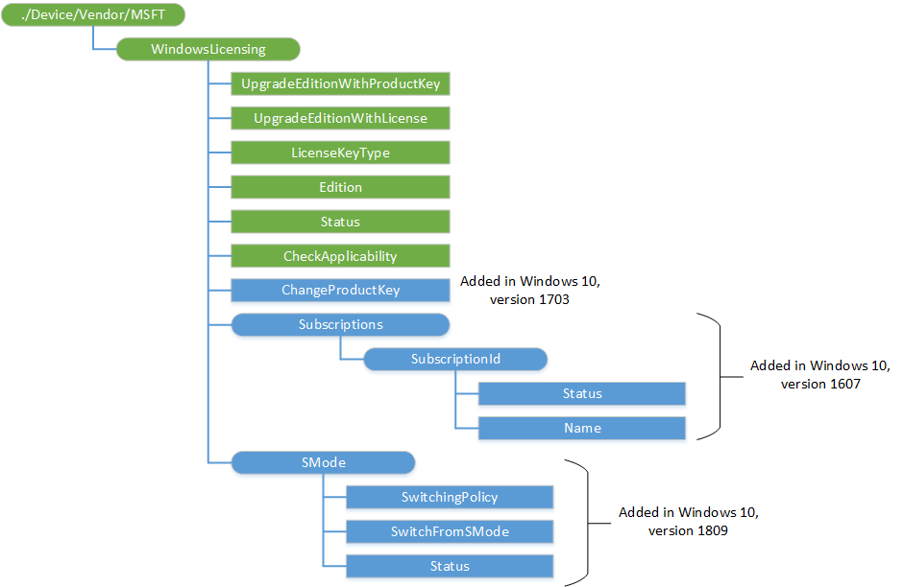

WindowsLicensing CSP
The WindowsLicensing configuration service provider is designed for licensing related management scenarios. Currently the scope is limited to edition upgrades of Windows 10 desktop and mobile devices, such as Windows 10 Pro to Windows 10 Enterprise.

Slide 16
CSP Reference
For the complete reference list, please go to:
https://docs.microsoft.com/en-us/windows/client-management/mdm/configuration-service-provider-reference#csp-support

Slide 17
Thank You

